Slide 1
DISK RENTAL STORE MANAGEMENT
SYSTEM
Pham Minh Tan - 19520261
Bui Duong Duy Khang - 19520618
Nguyen Van Dat - 19521347
Instructors: Le Thanh Trong
Notes:
Nowadays, with the significant grow in information technology, almost every business can be managed and stored in the computer, which mean now we can use computer to manage the flow in all levels of store. Thus, this project helps to make a software which can support for a disk rental store in its daily business. To make the project adapt to the scope of the subject, the project will be built by using C# language and .NET framework follow the MVVM Architect. The database administrator will be used is MySQL and use Docker to deploy it

Slide 2

01. ARCHITECTURE GOAL
02. USE CASE VIEW
03. LOGICAL VIEW
04. PROCESS VIEW
05. IMPLEMENTATION VIEW
06. DEPLOYMENT VIEW

Slide 3

01. Architecture goal
User side
+ Online: By using Azure Server, all client can access system easily.
Windows OS: Project is developed on C .NET which have over 70% computer devices in the word

Slide 4


01. Architecture goal
MVVM

Slide 5
01. Architecture goal
Requirement | Value
Several concurrent users | 2
Several business users | 3
Level of availability | 97-99%
Usage frequency | The system is used every day (24/24) (Except for the monthly maintenance.)
Security | Encrypt Password Decentralization between Admins and Staffs
Performance | The system needs to achieve high performance.
Portability and reuse | The system should be able to be reused by properly separating modules. To maintain reusability, all the functionalities are very well structured and layered.
Persistence | Databases must ensure safety (minimize data loss) and confidentiality to ensure maximum customer data security.

Slide 6
02. Use case view
# | Actor Name | Definition
1 | Staff | Is a staff of the store, one store has more than 1 staff
2 | Manager | Is a manager of the store, one store must have only one manager, could do all use case.
3 | Print system | Is a print system of the store

Slide 7
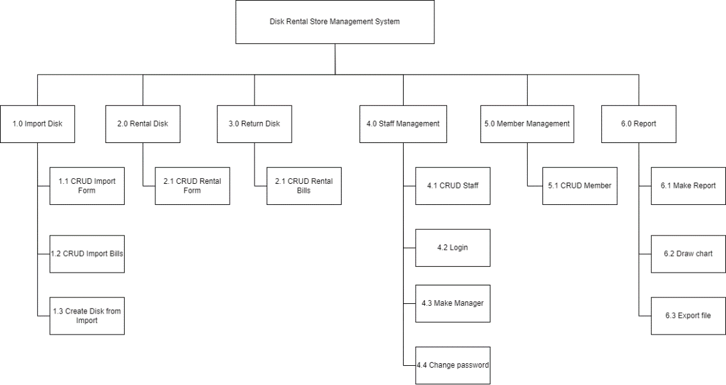
02.1 Use case List

Slide 8
02.1 Use case List
.No | Name of Use-case | Short description/Notes
1 | Disk management | Manage all disk of the store, normally include retrieve, create, update, delete disk.
2 | Retrieve disk | Retrieve disk extent from disk management.
3 | Create disk | Create disk extent form disk management and include when receive absolutely new disk from provider.
4 | Staff management | Manage all staff of the store, normally include retrieve, create, update, delete.
5 | Order new disk | Order new disk for store
6 | Receive disk from provider | Receive disk when provider delivered its to store

Slide 9
02.1 Use case List
.No | Name of Use-case | Short description/Notes
7 | Membership management | Manage all member of the store, normally include retrieve, create, update, delete.
8 | Create membership | Create new member extent membership management
9 | Update membership | Update member when customer ask to do this extent membership management.
10 | Reserve disk for customer | Reserve disk for customer
11 | Delete reserve | Delete reserve will call automatically when renting reserved disk.
12 | Disk rental | Give disk and rental bill to customer
13 | Disk returning | Receive disk from the customer check quantity and qualification disk.
14 | Reporting | Retrieve report of the store

Slide 10
02.1 Use case List
.No | Name of Use-case | Short description/Notes
15 | Pay fire | Charges additional fee
16 | Print reserve bill | Print reserve bill automatically when disk reserve done
17 | Print rental bill | Print rental bill automatically when disk rental done
18 | Print report | Print report when manager require

Slide 11
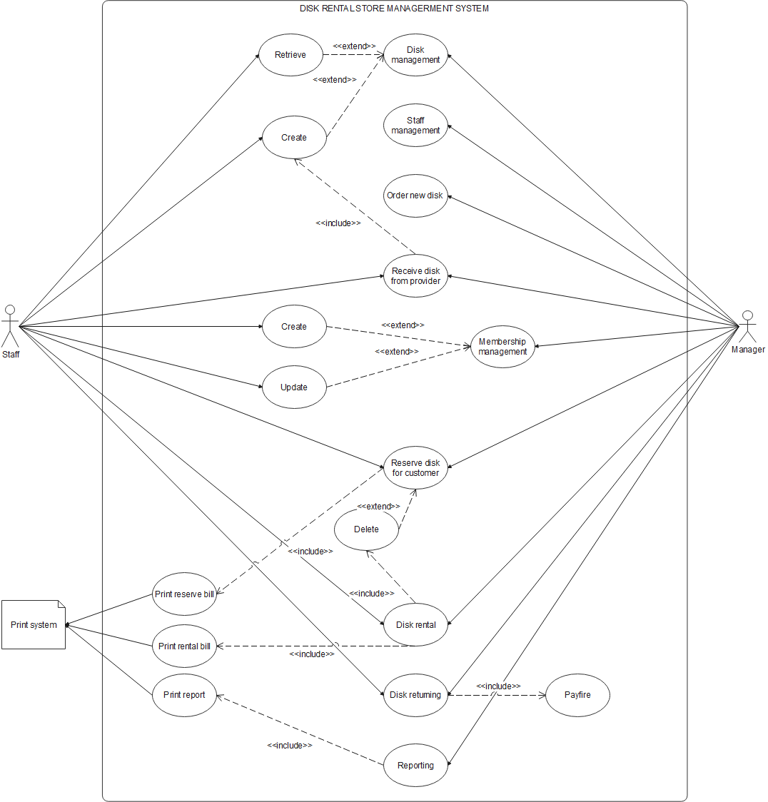

Slide 12
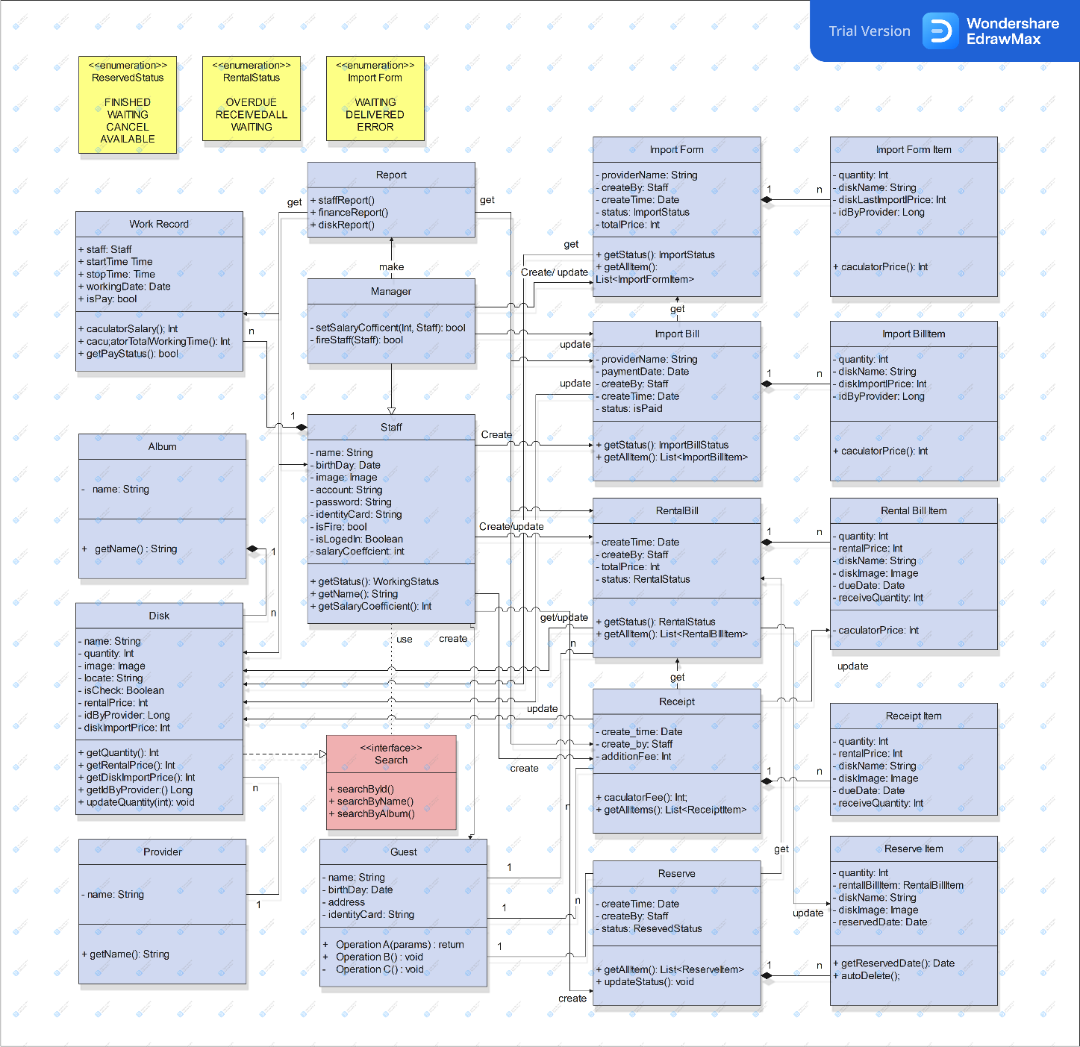
03. Logical view

Slide 13
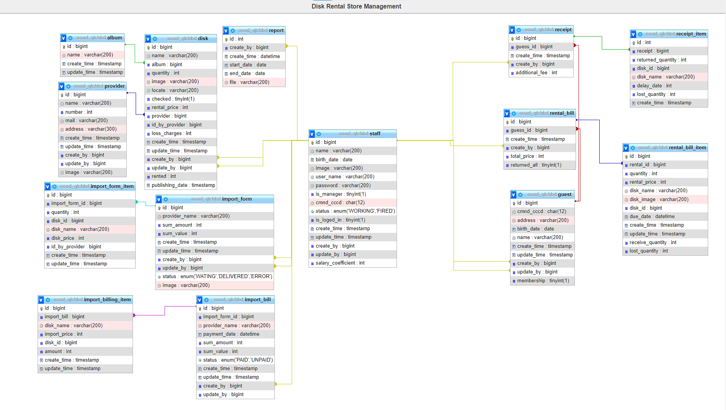
03. Logical view
ERD

Slide 14
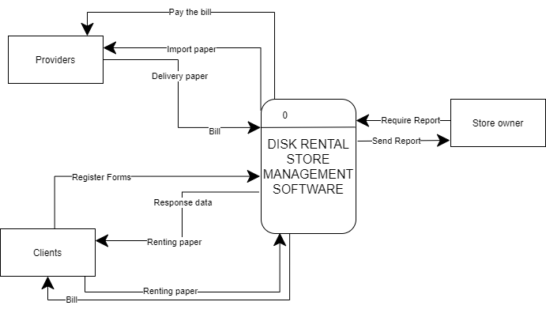
04. Process view

Slide 15
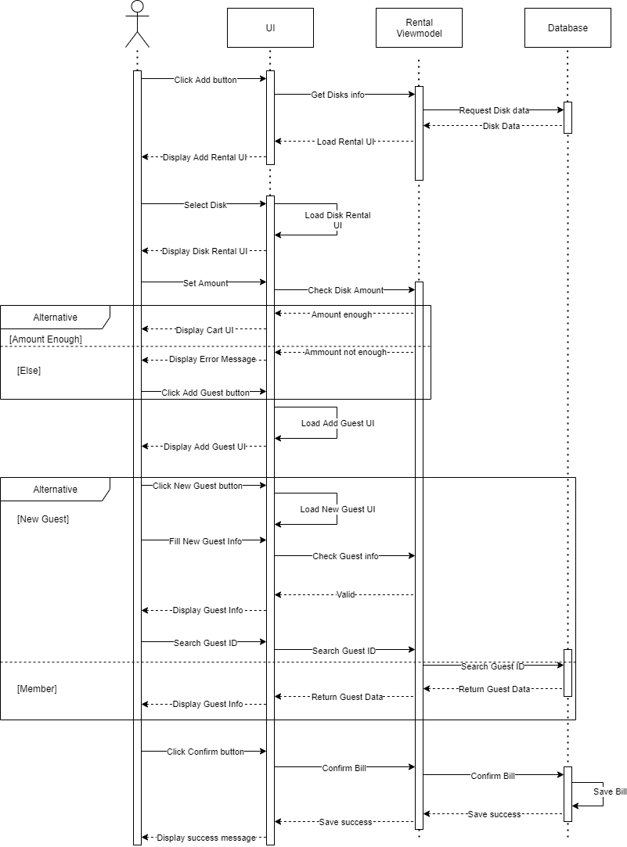
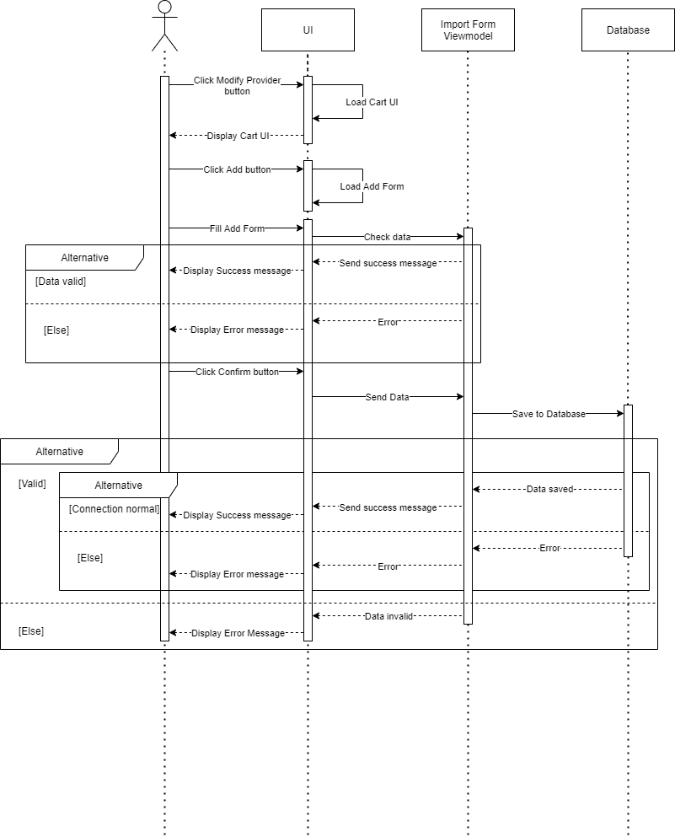
04. Process view (Sequence Diagram)

Slide 16
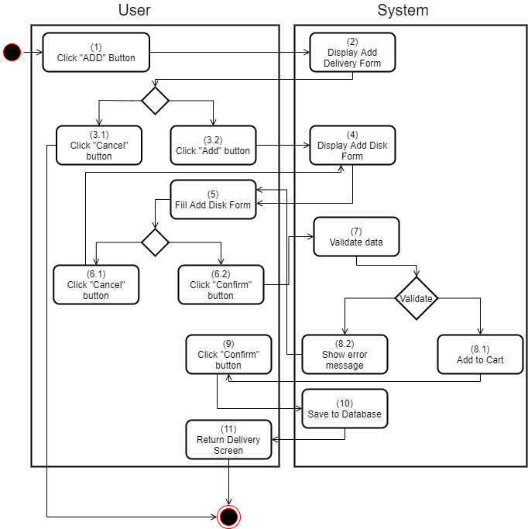
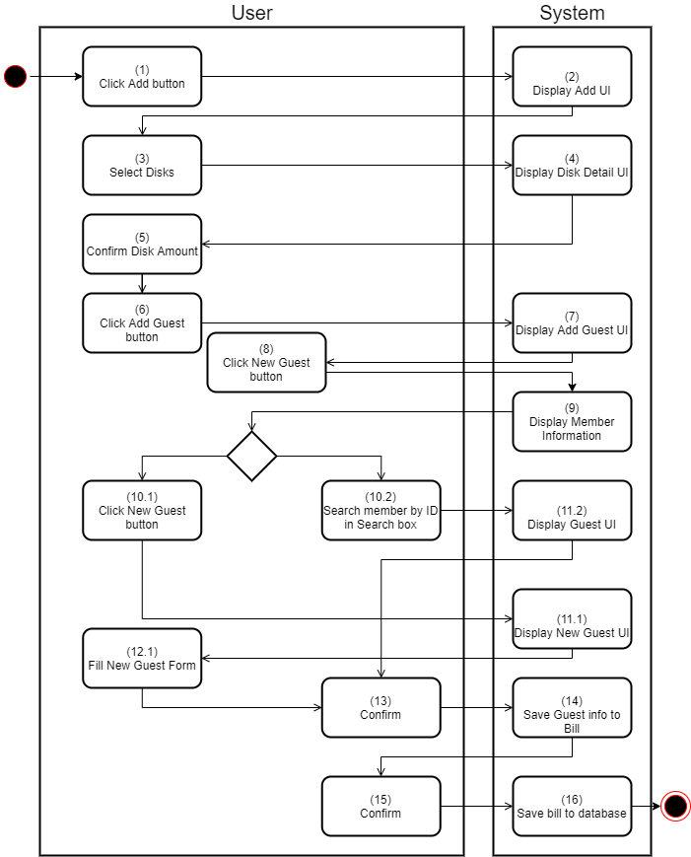
04. Process view
04. Process view (Activities Diagram)

Slide 17

05. Implementation view

Slide 18
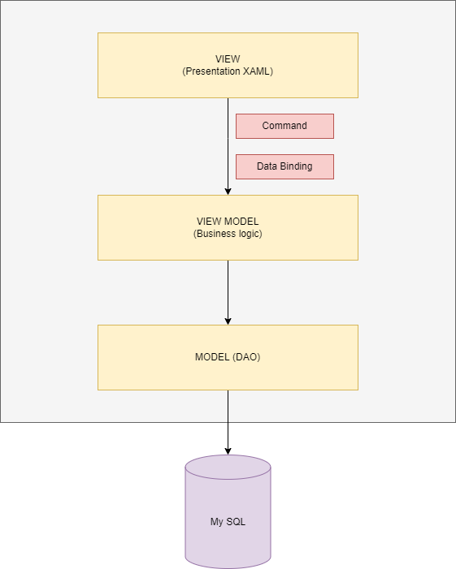
06. Deployment view
Layering

Slide 19
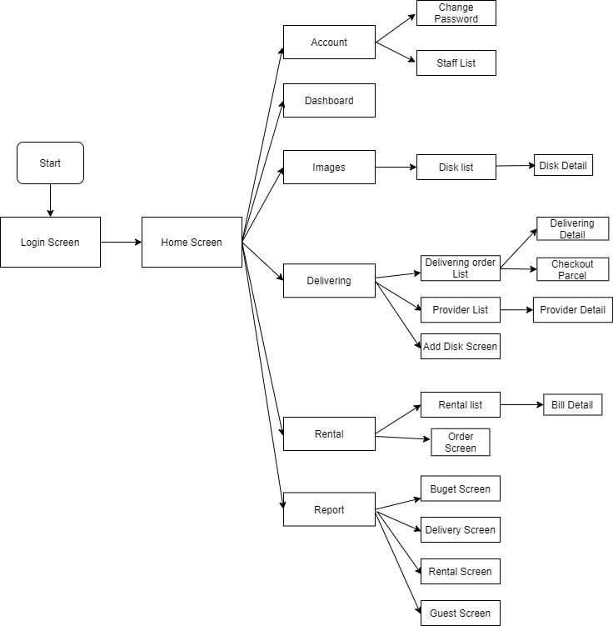
Screen flow

Slide 20
Disadvantage of the system.
Server has low performance.
Not appropriate for big companies.
Not automatic completely

Slide 21
Thanks for listening

